Slide 1
Allocation of resources to maximize the impact of HIV funding in Kazakhstan
2025/26 analysis: Final results
April 2026

Slide 2
Background
While overall new infections are declining in Kazakhstan (Spectrum estimates), incidence may be increasing in some populations.
Among men who have sex with men (MSM), HIV prevalence has increased from 1.2% in 2013 to 8.8% in 2023.
People who inject drugs (PWID) and female sex workers (FSW) are also disproportionately affected by HIV.
Due to upper-middle income status, Kazakhstan has faced barriers to accessing cheaper generic drugs but now has access to low-cost dolutegravir for first-line treatment.
Domestic share of HIV spending increased from 87% to 94% between 2021 and 2024.

Slide 3
Objectives
What are the projected HIV epidemic outcomes (infections, deaths, and people living with HIV) by 2030 under status quo (current trends continued)?
What are the projected HIV epidemic outcomes by 2030 if international funding for HIV is discontinued and not not replaced, or reduced?
What is the optimized resource allocation by targeted HIV intervention to minimize HIV infections and deaths by 2030 under five funding scenarios of 50%, 75%, 100%, 150%, and 200% of the current funding HIV?
What is the expected cascade (gap) and number of HIV infections and deaths averted through budget optimization under these scenarios?

Slide 4
Methods
MODEL | Optima HIV, a compartmentalized population-based model of HIV transmission and disease progression integrated with an economic and programmatic analysis framework
DATA INPUTS | Demographic, epidemiological, behavioral, programmatic, and expenditure data were collated from behavioural surveys, public and country-provided data.
CALIBRATION | Historical epidemic trends were calibrated closely to align with national HIV estimates from 2025 UNAIDS Spectrum and population-specific HIV prevalence estimates.
BASELINE YEAR | 2025. Expenditure data were based on top-down estimates in 2024 provided by KSCDID. 2025 spending was assumed to be the same except for ART-assumed to increase to maintain same % coverage among people diagnosed
ANALYSIS | Optimized spending scenarios at different budget levels determine the most cost-effective allocation of HIV prevention and testing services to minimise new HIV infections and HIV-related deaths over 2026 to 2030
CONSTRAINTS | All budget levels were constrained to not reduce spending for treatment interventions. Other spending was constrained to not be reduced by more than 50% except in 50% spending optimized scenario. At the 50% and 75% budget levels the total budget was insufficient to maintain those constraints so all constrained interventions were scaled proportionally.

Slide 5
Populations included in the analysis
Key populations (aged 15-49) | Non-key populations
Female sex workers (FSW) | Males aged 0-14
Clients of female sex workers (Clients) | Females aged 0-14
Men who have sex with men (MSM) | Males aged 15-49
People who inject drugs (PWID), male | Females aged 15-49
People who inject drugs (PWID), female | Males aged 50+
Other men at high risk | Females aged 50+

Slide 6
Modelled HIV programs
Antiretroviral therapy (ART), including lab monitoring and treatment adherence and retention support
Prevention of mother-to-child transmission (PMTCT)
Opioid substitution treatment (OST)
Facility-based testing services for non-key populations (HTS)
Condom programs for people outside key populations (Condoms)
HIV prevention and testing services for PWID, including needle-syringe program (PWID programs)
HIV prevention and testing services for FSW (FSW programs)
HIV prevention and testing services for MSM (MSM programs)
Pre-exposure prophylaxis for FSW, MSM, and PWID (PrEP)

Slide 7
Modelled scenarios
Scenario | Description
Status quo | Continued current trends assuming fixed coverage of all HIV prevention and testing services maintained until 2030, and the proportion of diagnosed people on treatment maintained according to most recent data.
Counterfactual scenario (100% spending) | 2025 spending on HIV prevention, testing and treatment services maintained until 2030.
HIV prevention and testing removed from 2026 | Assuming that all services other than ART, PMTCT, viral load monitoring, opioid substitution treatment and facility-based HIV testing are removed from 2026 onwards. ART and PMTCT are assumed to remain fixed at the most recent proportion of diagnosed people living with HIV.
Optimized spending | Determines the most cost-effective distribution of spending across HIV programs to minimise new HIV infections and HIV-related deaths over 2026 to 2030 at different budget levels.
Optimized spending with sufficient resources to maintain fixed treatment coverage | Determines the level of resources required to maintain fixed treatment coverage (proportion of diagnosed people living with HIV) and assesses the most cost-effective distribution of spending across HIV prevention, testing and treatment programs to minimise new HIV infections and HIV-related deaths over 2026 to 2030.

Slide 8
Resource needs to maintain most recent ART coverage
Estimate $38.6 million spent on targeted HIV programs in 2025.
If 2025 spending is fixed (counterfactual), then the number of treatment will remain constant while the number of people diagnosed continues to increase given ongoing testing, leading to a reduction in proportional treatment coverage.
The status quo projects continued current trends based on the proportion of diagnosed people on treatment and may be the most accurate projection of the HIV epidemic if funding for continued ART is guaranteed.
Maintaining the status quo will require additional resources for treatment (ART and PMTCT) → estimated $6.7 million per annum.

Slide 9
Optimized spending with sufficient resources to meet treatment demand
Given the Government’s commitment to continue to provide HIV treatment to all those in need, the budget optimisation with additional resources to meet treatment demand is most relevant to local planning.
With 2025 spending plus an additional $6.7M p.a. available (minimum amount required to maintain status quo treatment coverage), can increase epidemic impact by scaling up:
ART & PMTCT
HIV prevention and testing services for MSM & PWID
PrEP for MSM
+ Maintaining facility-based testing services and PrEP for people who inject drugs.
* $6.7M calculated based on the necessary resources to maintain status quo treatment coverage (ART & PMTCT) prior to optimization.

Slide 10
Impact of scenarios with sufficient resources to maintain latest reported treatment coverage
Optimized allocation of 2025 spending +$6.7 million p.a. could avert 1014 (-12%) new HIV infections and 22 (-1%) HIV-related deaths over 2026-2030 compared to the status quo.
Even if treatment coverage and facility-based testing could be maintained, removing prevention and other testing services could lead to an additional 4276 (+50%) new HIV infections and 59 (+3%) deaths over 2026-2030.

Slide 11
Optimized resource allocation at different budget levels
First priority, even with reduced funding:
Increase resources for treatment in order to stabilise treatment coverage
With current resources optimized, additionally:
Expand HIV prevention and testing services for MSM, including PrEP
Expand services for PWID
With increased resources available:
Expand facility-based testing for people outside of identified key populations
Expand HIV prevention test services for PWID and FSW
Scale up PrEP for PWID

Slide 12
Impact of optimized spending on new HIV infections
The counterfactual scenario would lead to a rebound in new infections compared to status quo due to declining treatment coverage if spending is fixed.
Optimizing 100% spending can avert this increase and lead to a 30% decline in new infections and 31% decline in deaths over 2026-2030 compared to the counterfactual.
Impact increases to a 44% reduction in infections and 41% reduction in deaths with 150% spending optimized.
Reducing HIV spending could accelerate increases in new HIV infections and deaths.

Slide 13
Impact of optimized spending on HIV treatment cascade
With 100% spending optimized could reach 80% diagnosis, 87% treatment coverage among people diagnosed, and 90% viral suppression among people on treatment.
Additional programs that focus prevention and testing services to people at high past or present risk of acquiring HIV may make it possible to reach the 95% diagnosis target more cost-efficiently.
Unit costs for treatment in Kazakhstan remain above regional averages.

Slide 14
Limitations
  There is uncertainty in population size estimates: stigma may lead to underestimation of population size for key populations.
  Epidemiological indicators come from population surveys or programmatic data that have varying degrees and types of biases.
  The model calibration is sensitive to behavioral changes including the reduced number of people who inject drugs, the reduced frequency of injecting and sharing needle/syringes, and sexual partnerships. If these reported data are not fully representative, it is possible that the size of the epidemic is under- or over-estimated within individual key populations.
  Geographical heterogeneity is not modelled, and outcomes represent national averages.
  The status quo and other scenarios with fixed proportional treatment coverage likely overestimate new HIV infections and HIV-related deaths due to expected annual gains in proportional treatment coverage if recent progress continues.
  Cost functions for each program are a key driver of model optimizations. There is uncertainty in the shapes of these cost functions, values which could influence how easily or how high programs could be scaled up.
  Retention in care: There is a gap in strategic information where some diagnosed people living with HIV are neither reported to be on treatment nor lost to follow-up, and it was assumed that additional spending on ART would be able to return these people to treatment.
  The cost of maintaining the status quo scenario may overestimate treatment costs if unit costs decrease overtime but may underestimate spending required to maintain coverage of testing and prevention services due to population growth.
  Optimized spending assumes that reallocation happens immediately in 2026 and is maintained through 2030, which may overestimate epidemic impact over 2026 to 2030. In practice, budget reallocation and program scale-up may be constrained by multi-year procurement contracts, workforce agreements, political considerations, logistical constraints and community acceptability.
  Equity and benefits outside of HIV were not considered in the optimization but should be factored into programmatic and budgeting decisions. Testing services, even if low yield, can play an important role for surveillance.

Slide 15
Conclusions
  Given the Government’s commitment in Kazakhstan to continue to provide HIV treatment to all those in need, the budget optimisation with additional resources to meet treatment demand is most relevant to local planning.
  Kazakhstan could reduce new infections by 12% compared to the status quo by scaling up HIV prevention and testing services for men who have sex with men and people who inject drugs, as well as investing more in treatment to meet the growing demand.
  Scaling up PrEP for men who have sex with men is expected to be cost-effective. Options for co-payment to increase the cost-effectiveness for other populations. While only a single PrEP modality was modelled, providing choice of oral or long-acting injectable PrEP may may increase uptake and continuation.
  Alongside targeted key population services, facility-based testing remains important to reach people at increased risk of acquiring HIV who may avoid accessing key population-focused services due to stigma, those who do not identify as key populations, and partners of key populations.
  Even if treatment coverage and facility-based testing could be maintained, removing prevention and other testing services could lead to a rebound in new HIV infections.

Slide 16
Acknowledments
This Optima HIV modeling analysis was conducted as a collaboration between the Kazakhstan country team and international partners in 2025-26.
Kazakh Scientific Center of Dermatology and Infection Diseases of the Ministry of Health of the Republic of Kazakhstan
Burnet Institute
The Global Fund
Sayrankul Kasymbekova
Musina Zhannat
Anna Bowring
Kelvin Burke
Rowan Martin-Hughes
Chris Seaman
Nick Scott
Debra ten Brink
Tom Tidhar
Nisaa Wulan
Nella Foley
Dumitru Laticevschi
Corina Maxim
Svitlana Nidzvetsa
Vira Profazi
Mila Shkirko

Slide 17
Thank you

Slide 18
HIV program unit costs in 2024 and maximum potential coverage (saturation)
HIV program | Unit cost (US$) | Current coverage | Maximum potential coverage | Notes
HIV treatment | $760.52 | 31614 (87%)¹ | 100% | Includes ART, viral load monitoring, adherence and retention support.
Prevention of mother-to-child transmission | $719.37 | 530 (68%)² | 100%
Condom program | $7.78 | 96600 (1%) | 80% | Condom distribution among adults outside of key populations (M15-49 and F15-49) and other men at high risk.
Facility-based testing | $1.90 | 4,149,928 (29%) | 50% | Captures testing of people outside of key populations, including clients of FSW
Prevention and testing services for female sex workers | $26.45 | 18423 (84%) | 85% | Includes condom distribution and HIV testing
Prevention and testing services for men who have sex with men | $76.07 | 17728 (25%) | 50% | Includes condom distribution and HIV testing. Maximum potential coverage limited due to stigma.
Prevention and testing services for people who inject drugs | $27.87 | 52624 (66%) | 85% | Includes needle and syringe program, condom distribution and HIV testing
Opioid substitution treatment | $1,395.76 | 380 (0.5%) | 1% | Maximum coverage limited by policy constraints.
Pre-exposure prophylaxis (oral) | $46.65 | 3143 (4%) MSM 2722 (12%) FSW 4841 (6%) PWID | 15% MSM³ 20% FSW³ 15% PWID³ | Average annual cost per person. Assume those reached by PrEP have a relative risk of 2 of acquiring HIV compared to those not on PrEP. Assumes average continuation of 4 months.
1, Percentage of diagnosed people living with HIV; 2, percentage of pregnant women living with HIV; percentage of risk adjusted by relative risk of those on PrEP (assumed 2) and average continuation). Source: Unit costs derived through top-down estimation with total spending and coverage provided by the provided by KRCDIZ.

Slide 19
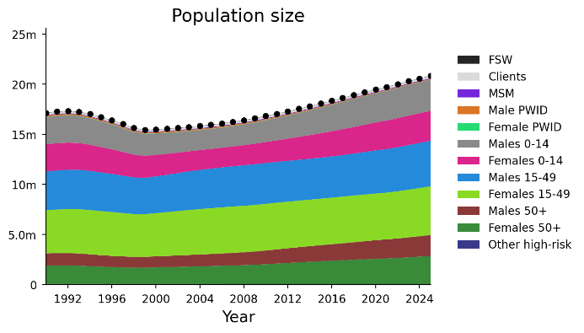
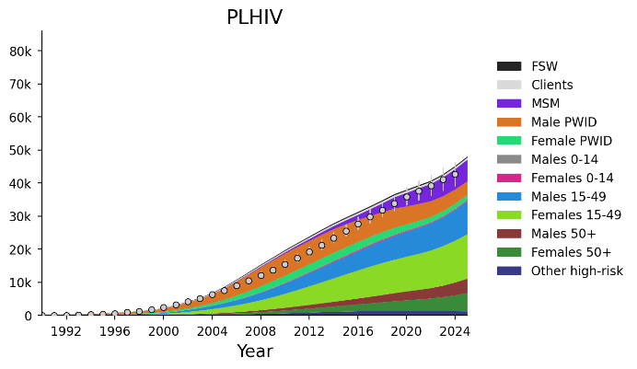
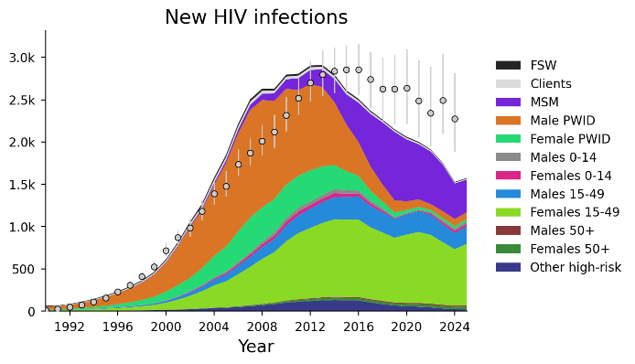
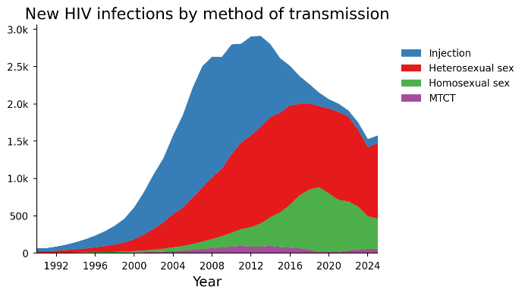
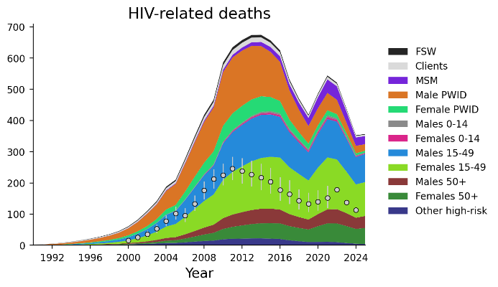
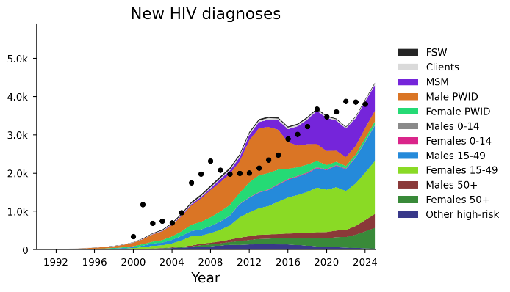
Calibration outputs
Note. Comparative data for deaths represents number of deaths HIV reported in national Electronic HIV Case-based Surveillance System. Optima modelled numbers expected to be higher because also captures deaths among undiagnosed people living with HIV.

Slide 20
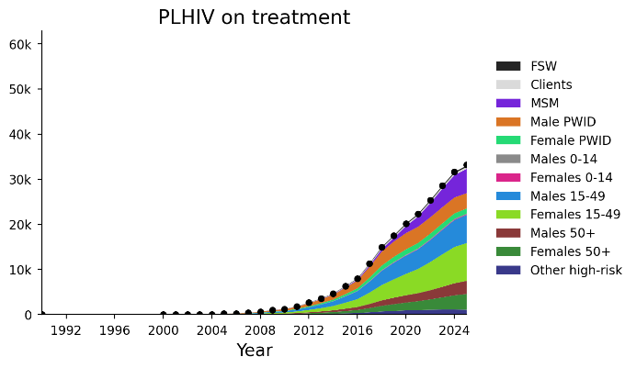
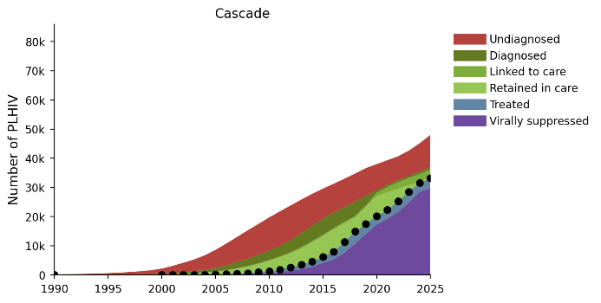
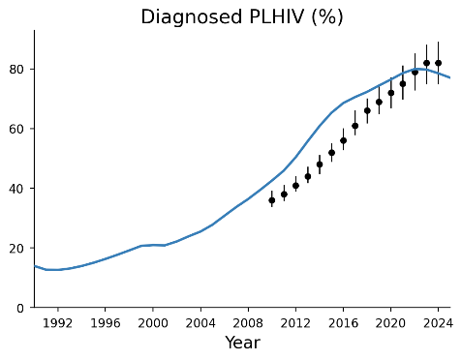
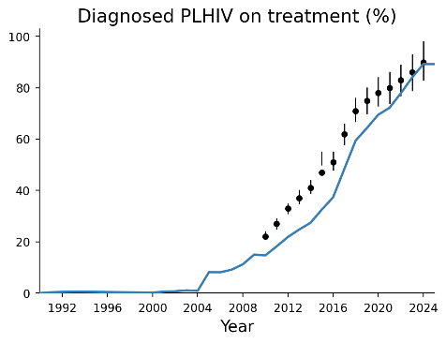
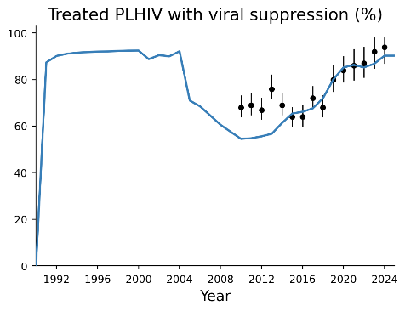
Calibration outputs

Slide 21
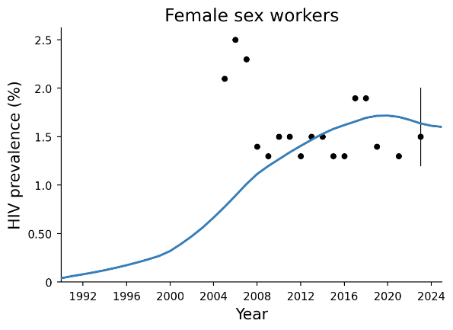
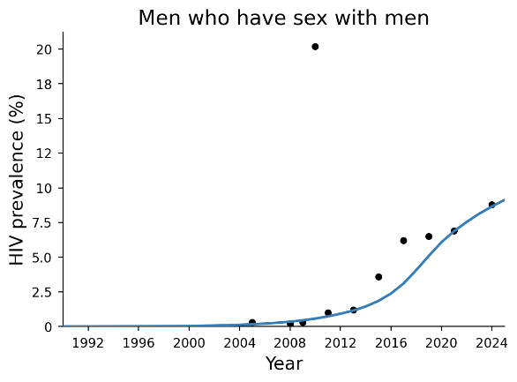
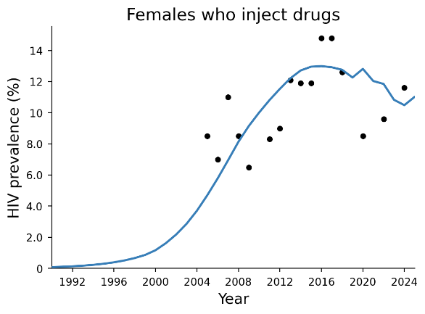
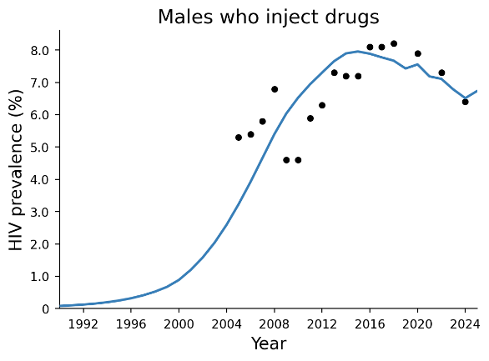
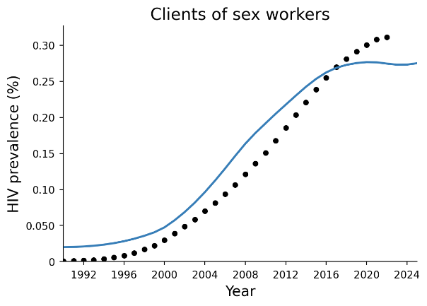
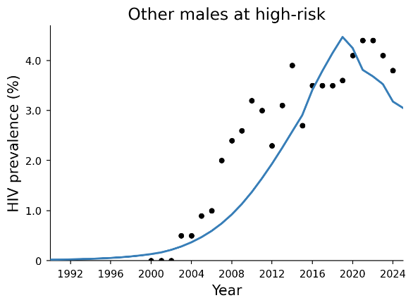
Calibration outputs

Slide 22
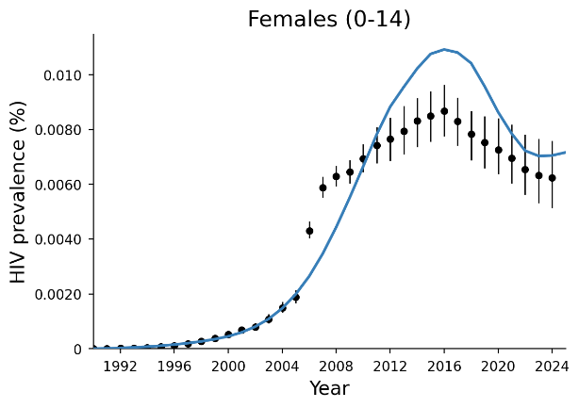
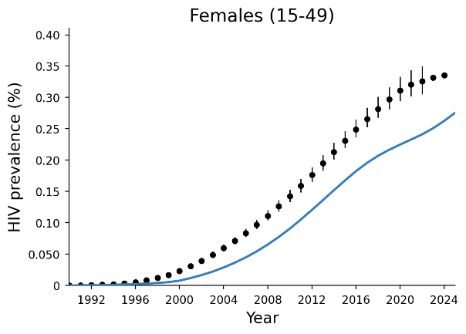
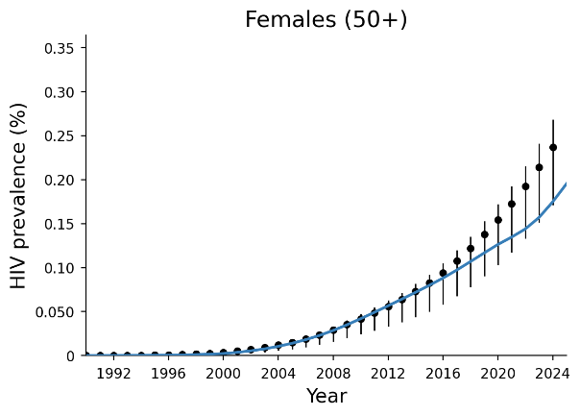

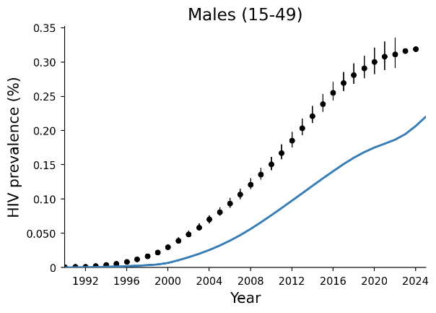
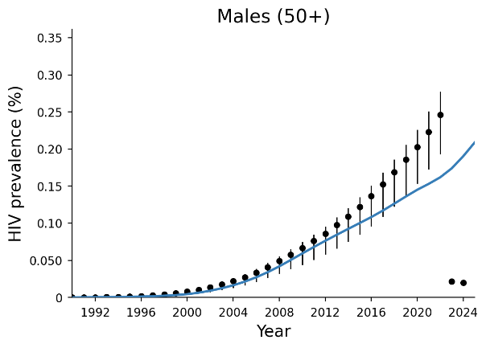
Calibration outputs

Slide 23
Sex disaggregation of new cases based on national surveillance reporting compared to Optima modelled estimates

